Slide 1
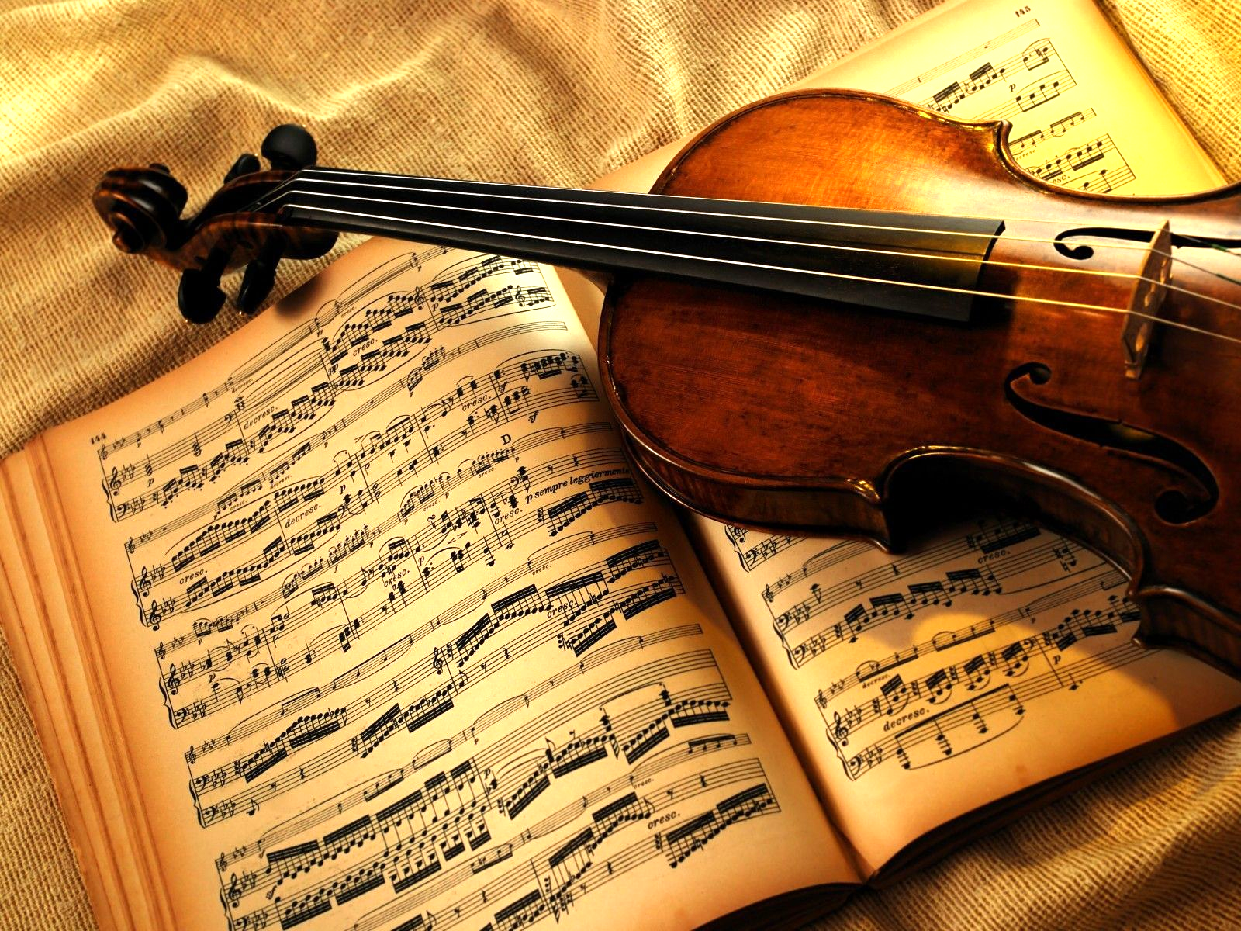
String Synthesizer Keyboard

Slide 2
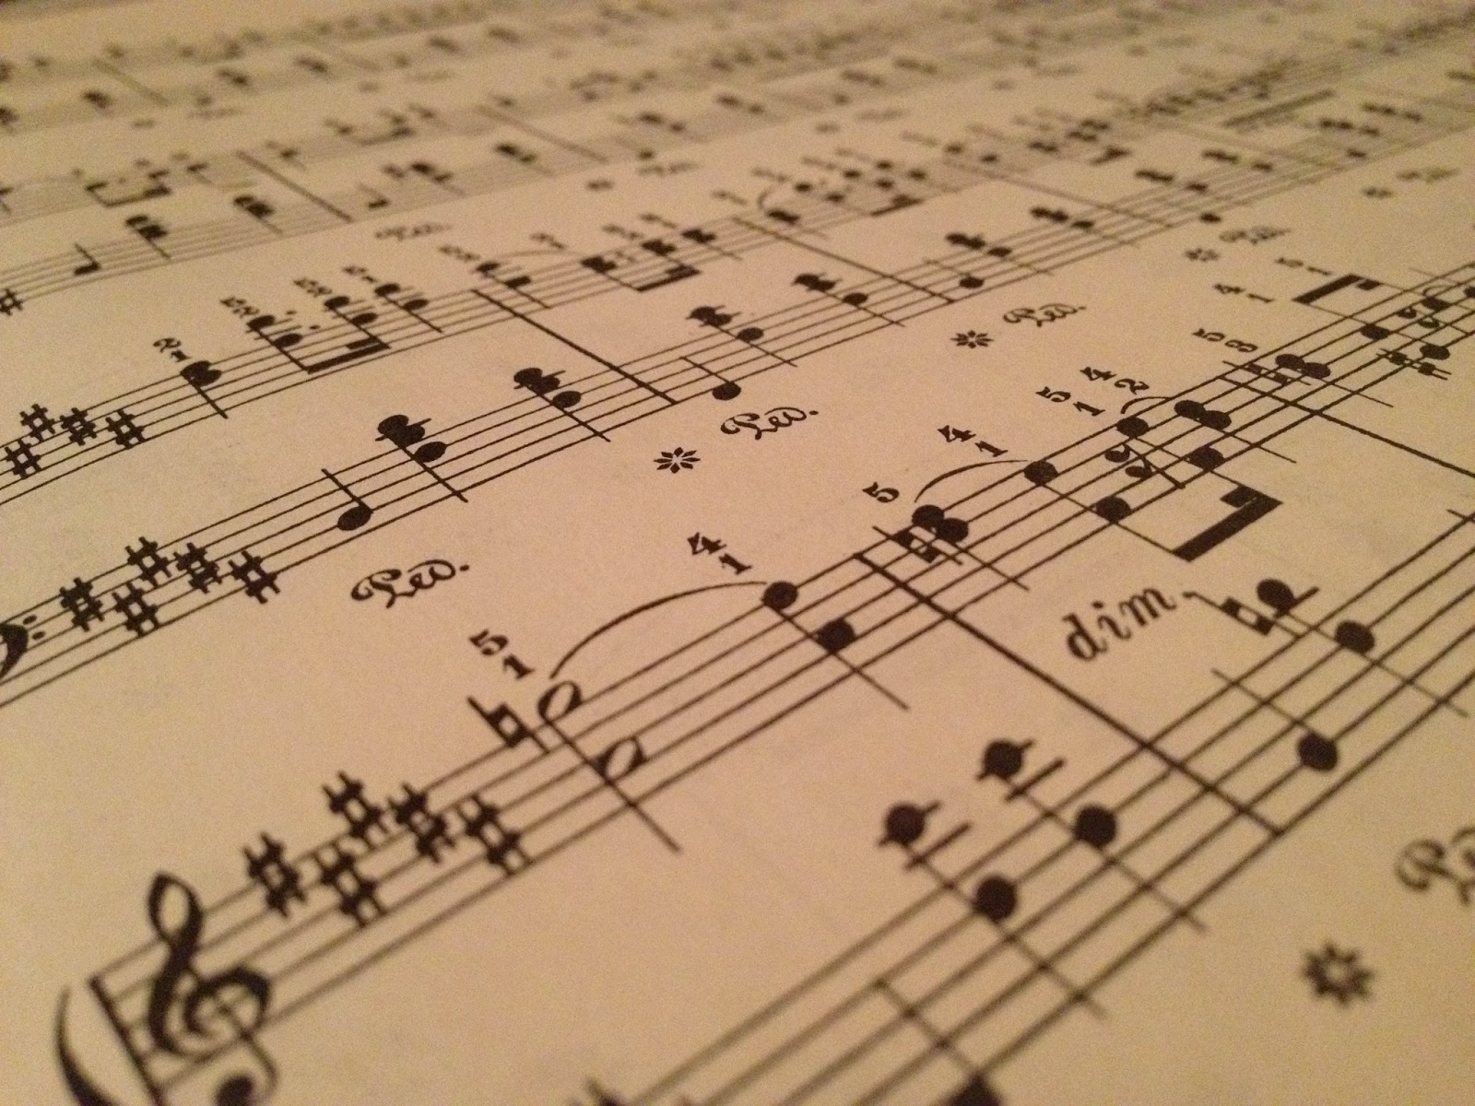
Introduction to Project
Focus on synthesis of two types of string instruments
Plucked (pizzicato)
Guitar
Bowed (arco)
Double Bass
Cello
Viola
Violin

Slide 3
Significance of Project
Contemporary music composers incorporate synthesizers in modern tunes
General purpose polyphonic synthesizers allows a wide range of instrument sounds to be played with a single equipment
Need for inexpensive human generated string ensembles
Non-professional musicians or hobbyist can also participate in creating music without paying a high price for musical instruments
Notes:
https://reverb.com/uk/news/a-brief-history-of-string-synths

Slide 4
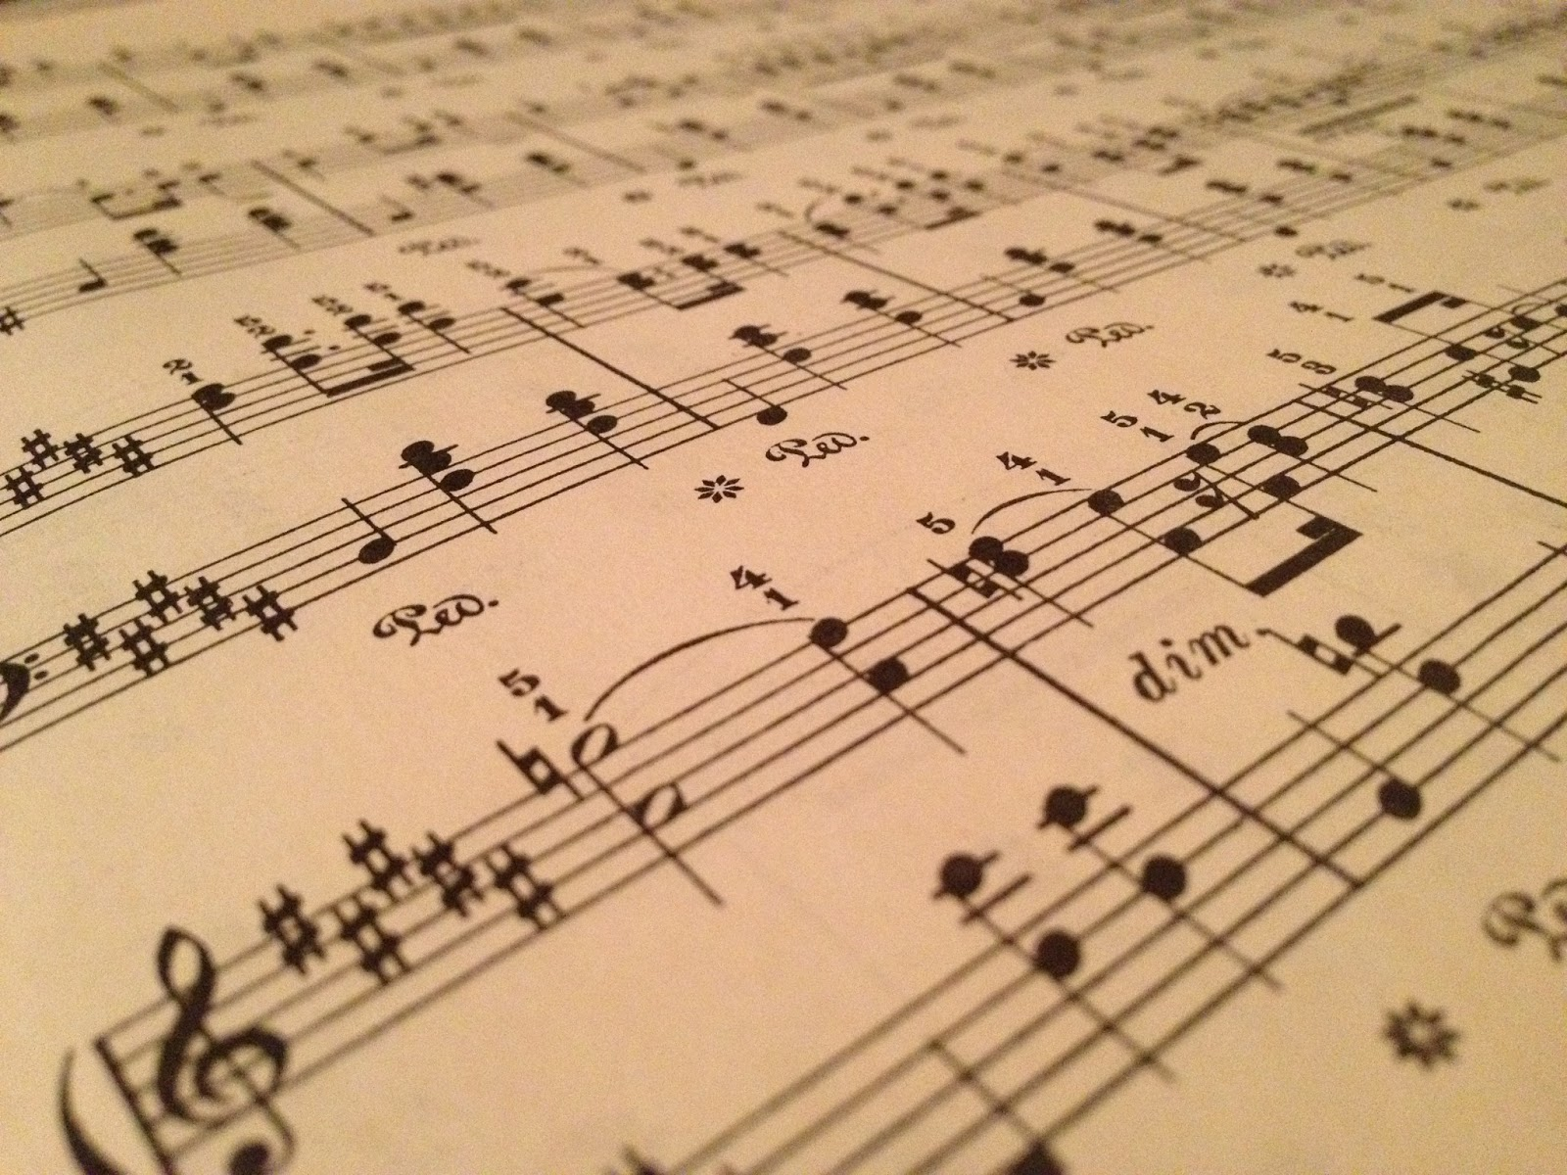
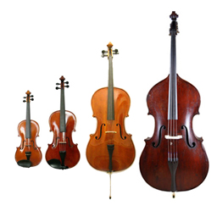
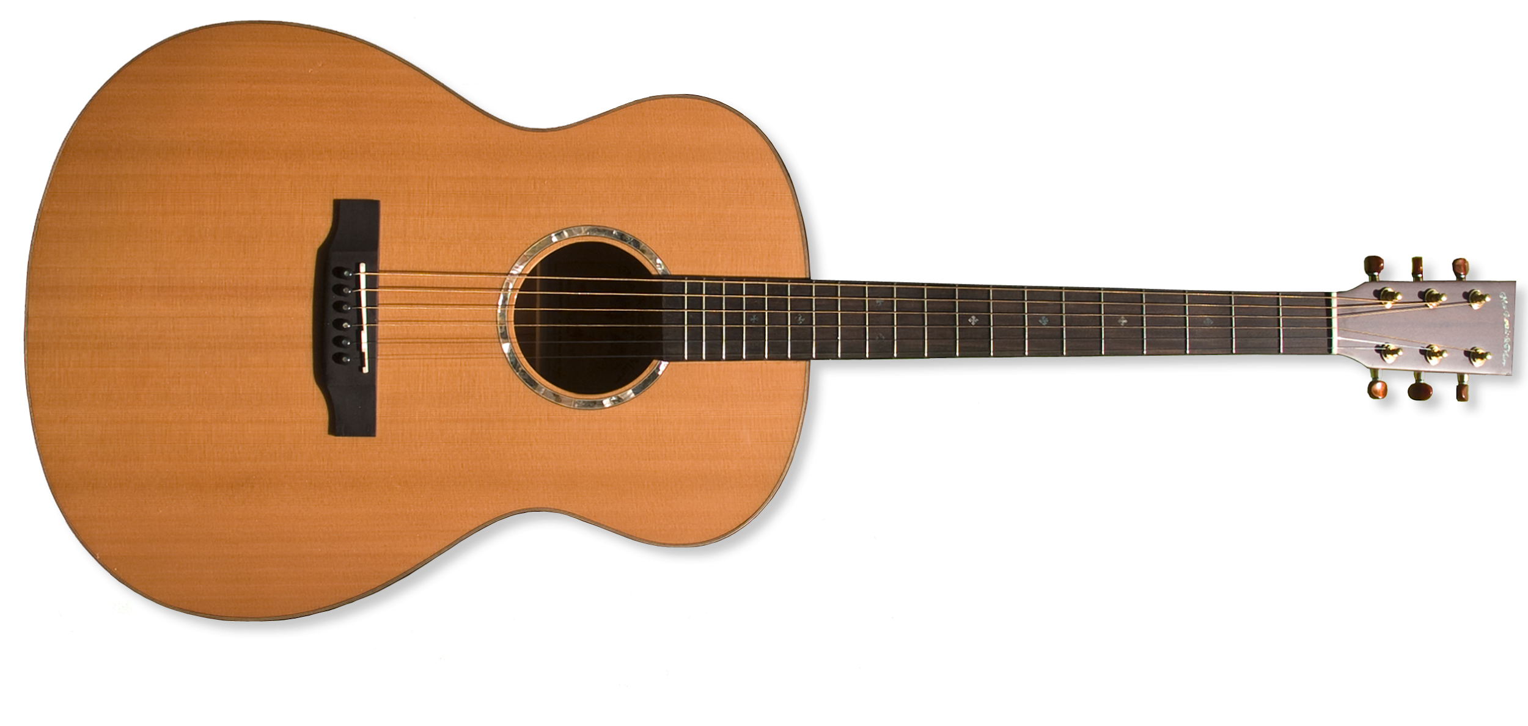
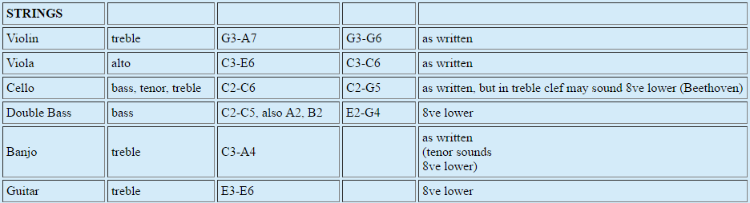
Music Theory
Pitch range: range of a musical instrument from the lowest to the highest pitch it can play

Slide 5
Digital Signal Processing Theory
Karplus Strong Algorithm
Physical modelling synthesis method
Simplest class of wavetable-modification algorithms (digital waveguide synthesis)
Loops a short waveform through a filtered delay line to simulate the sound of a plucked string
Can also be used to generate drum sound

Slide 6
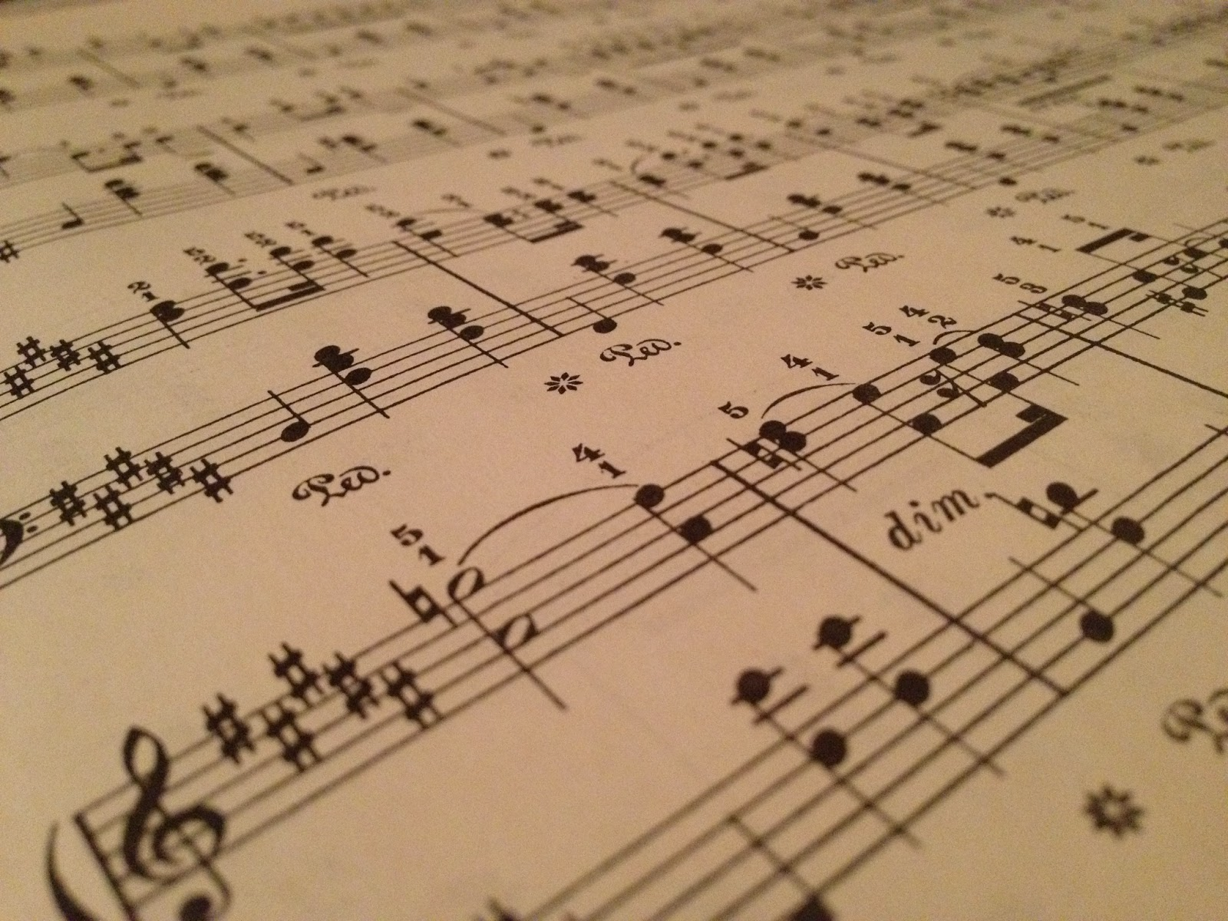


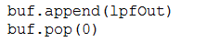
Digital Signal Processing Theory
Karplus Strong Algorithm:
Excitation of white noise is generated into a delay line
The delay line is pass through a filter (Read value from this buffer and average with the previous value)
Remove the first element of the delay line and append the new averaged value to the end

Slide 7
Digital Signal Processing Theory
Extended Karplus Strong Algorithm (Digital Waveguide) for violin
Generate low pass filter coefficients
Set up parameters for ( 1 ) delay line length ( 2 ) wavetable length ( 3 ) fractional delay value ( 4 ) allpass factor for allpass filter
Excitation of white noise is generated into a delay line
Perform a linear interpolation on delay line
Values inserted into delay line will be allpass filtered and low pass filtered

Slide 8
How project works
play_guitar() function will generate a plucked string sound for the duration of the key press
play_bowed() function will generate a bowed string sound for the duration of the key press
play_guitar() and play_bowed() will be called in real-time by the user pressing key(s) on the computer keyboard using Pygame
For polyphonic sounds, there will be a delay in the chord
Each function is assigned a frequency from the lookup dictionary note_tone_table

Slide 9
Sample Tones
Comparison of a real guitar and real violin generated sound to the synthesized sounds
Acoustic Guitar (real_guitar.wav) at 440 Hz (C4)
Violin (real_violin.wav) at 440 Hz (C4)

Slide 10
Demo

Slide 11
Improvements
More processing for improved tone at lower frequencies such as below C2 and higher frequencies such as above C5
Higher frequencies fade very quickly
Lower frequencies drag for too long
Consider the direction of bow strike and force used to play tone

